Slide 1
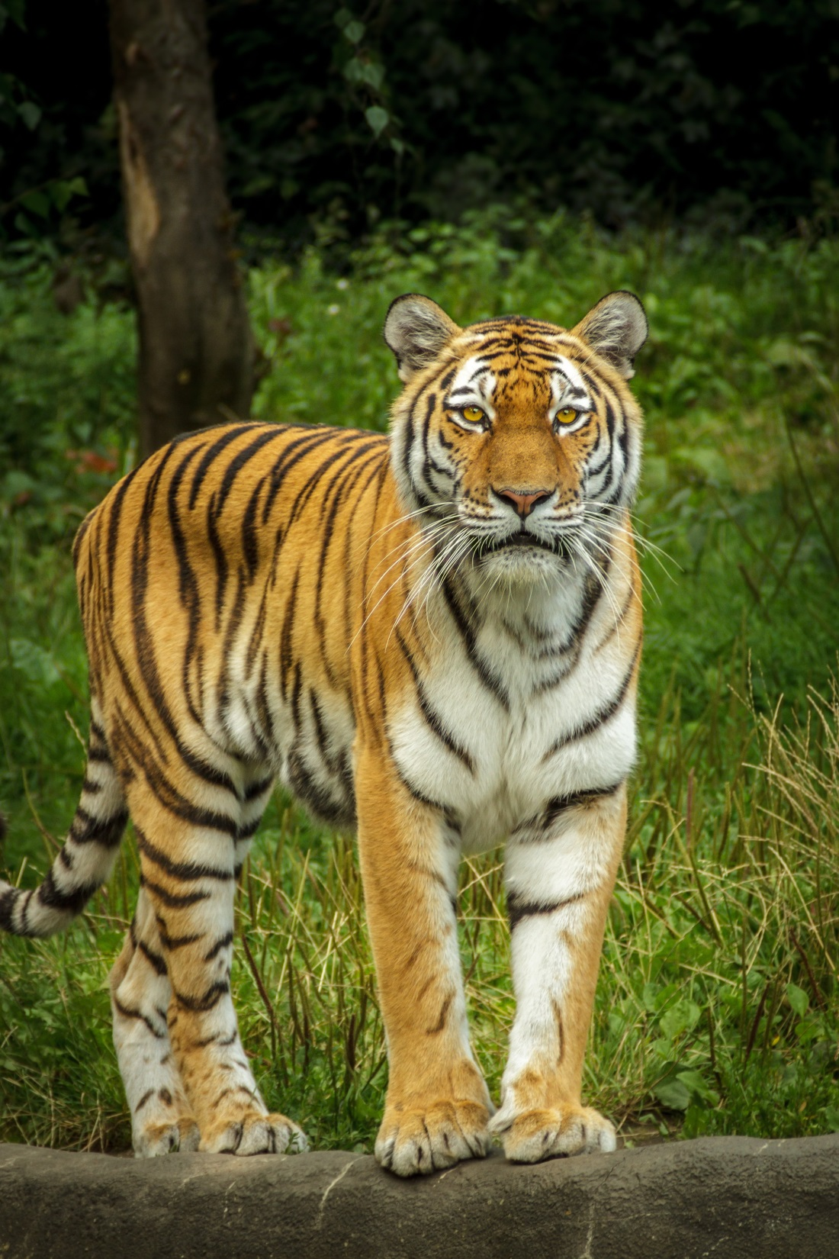
Classification of the Endangered Animals from Camera Trap Images
Presenters:
Harun Harman
Mustafa Cen

Slide 2
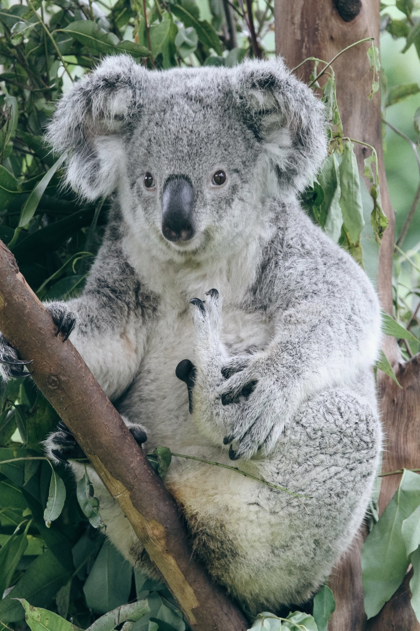
Outline
Problem Overview
- Importance of the problem
Dataset
- Data collection
Approaches
- Applied techniques
- Data augmentation
- Data processing
- Modeling
Evaluation
- Model comparison
-Strengths and Weaknesses

Slide 3
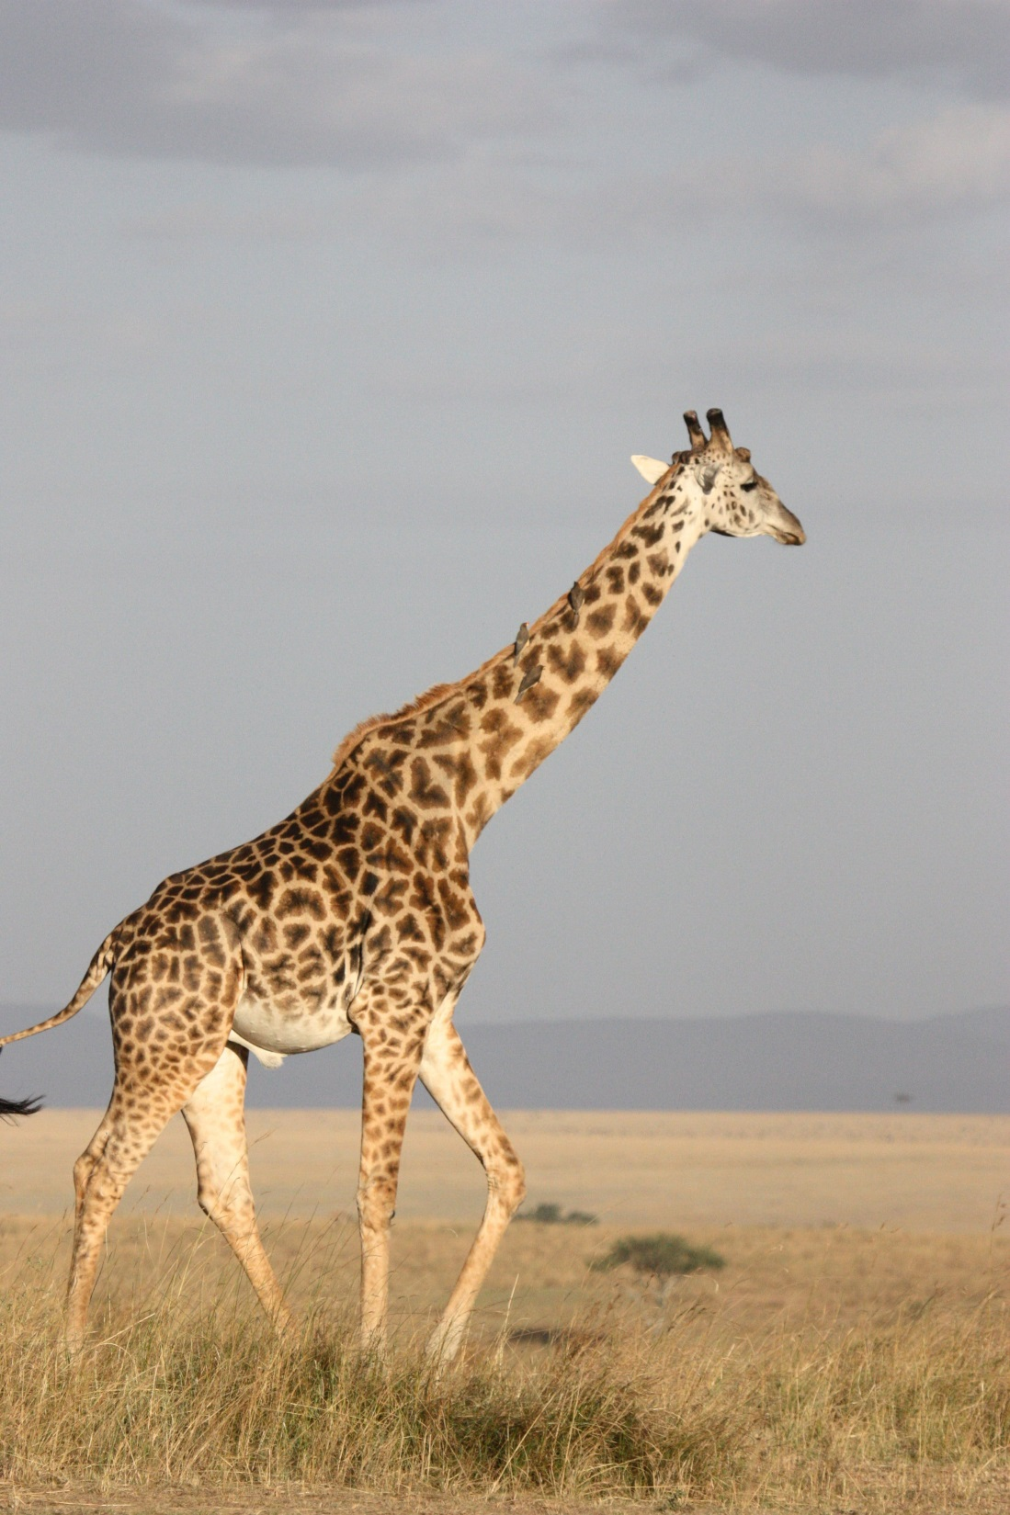
Problem Overview
The world is better with its own order.
In a regular and natural world ,the resources are fairly enough for every living creature.
Since the ‘’ Industrial Revolution’’ humanity increased its dominance in the world.
In those days since statistics is not well- used and the effects of the species extinction are not significant, as humanity, we did not care how the problem is significant and brutal.

Slide 4
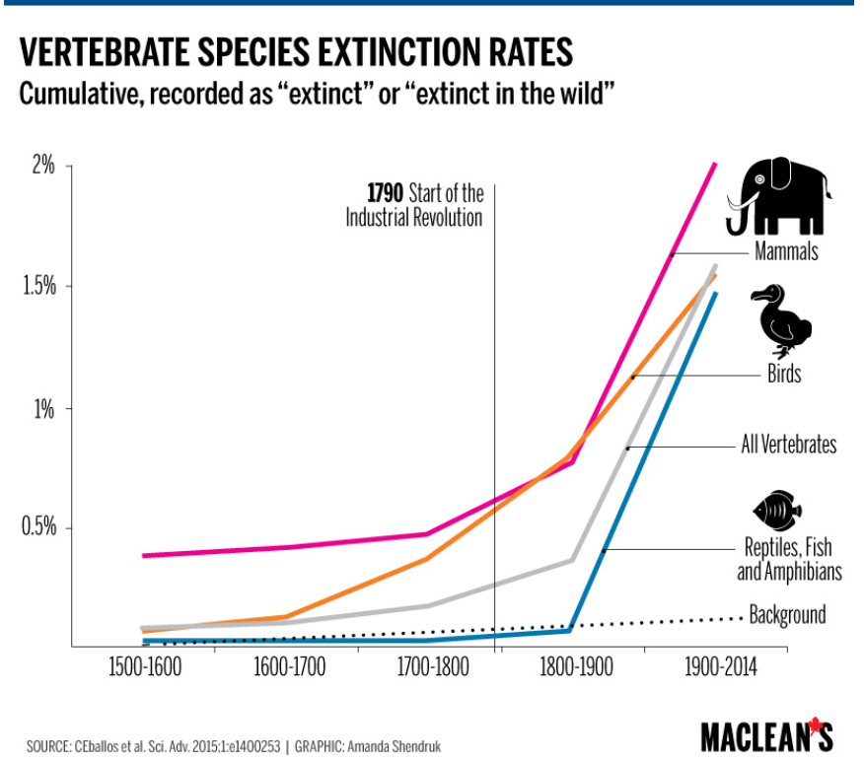
Figure 1, Species Extinction Rates

Slide 5
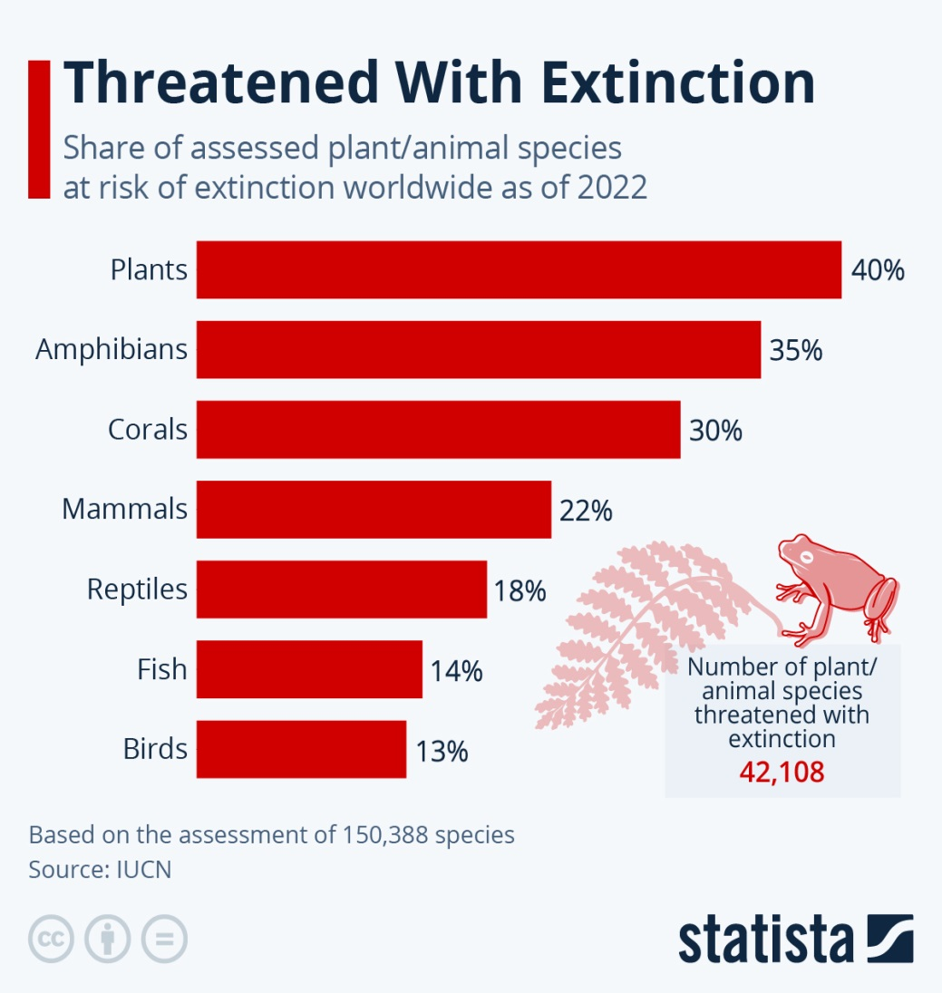
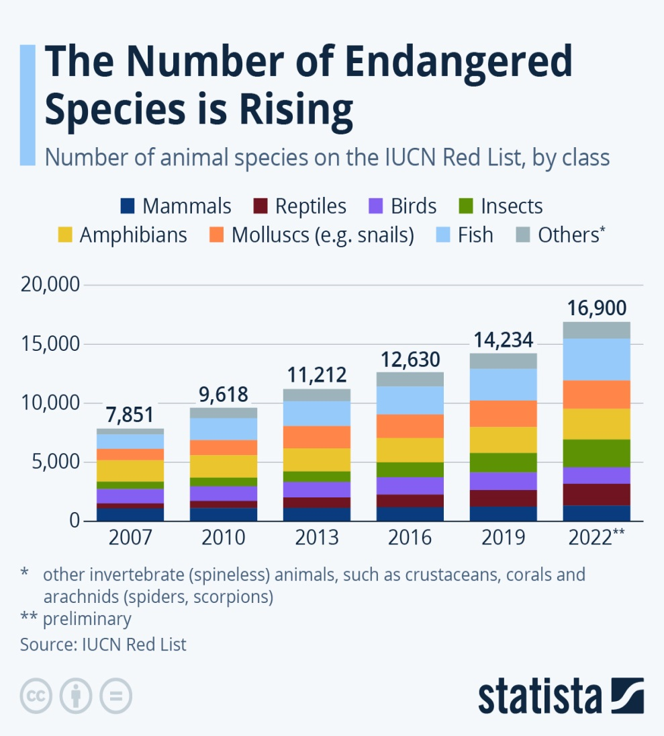
Figure 2, Number of organisms threatened with extinction
Figure3, The number of endangered species

Slide 6
Suggested Technological Solutions for the Problem
Predictive Analytics for Wildlife Conservation
By analyzing the data collected from various sources, researchers can predict potential threats and take proactive measures.
Conservation Drones
These drones can be used to monitor the habitats of endangered species, track their movements, and identify potential threats to their survival.
Satellite Imagery to Track Endangered Wildlife
It is an another way to keep track of the wildlife. Researchers can use this images to identify areas that need protection and to monitor the health of endangered species.
Networked Sensors ( Camera Traps)
Camera traps are popular way to keep track of the wildlife. Without disturbing the animals, it helps understanding the behaviour, health situation, existence of the animal etc.
Environmental DNA (eDNA)
Collecting the DNA from a limited area to identify the presence of the wild animals.

Slide 7
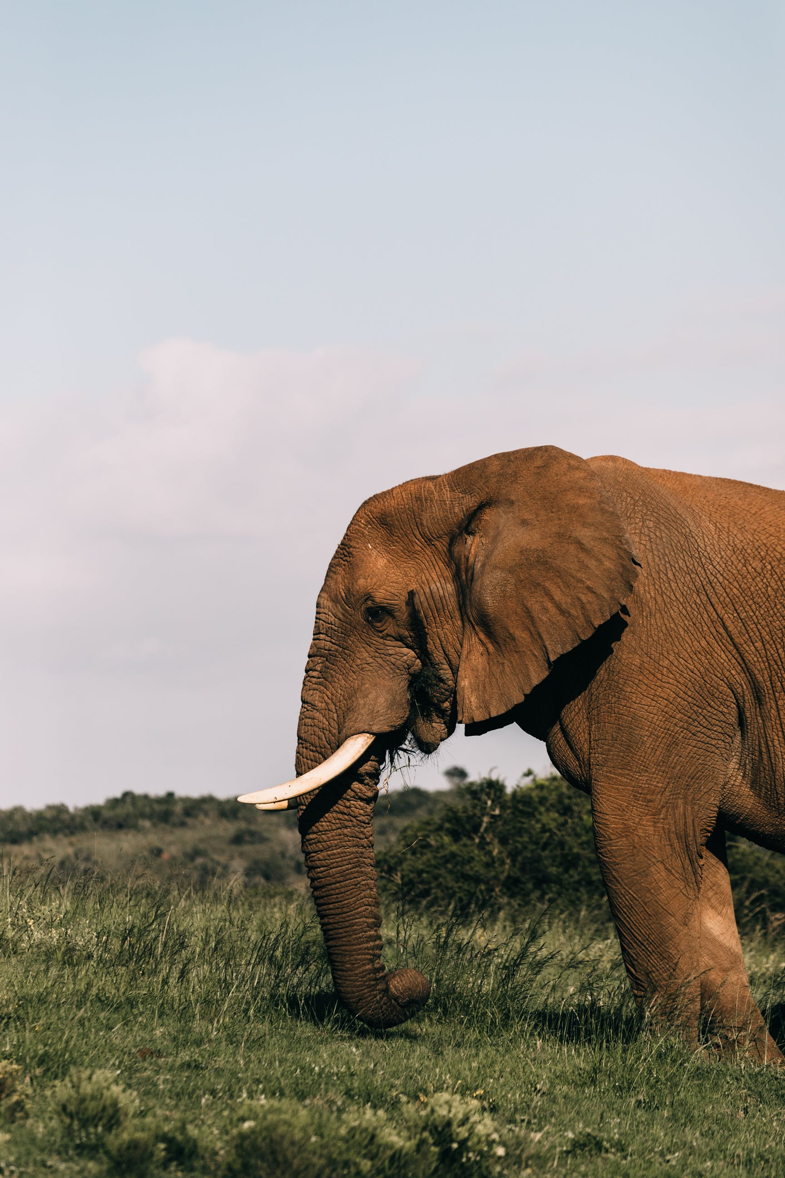
Dataset
In total, 35.641 images belonging to 10 different animals each are in different locations in the world.
The data set was obtained from 2 different data sets (WCS and Orinoquia) in lila.science from the GCP(Google Cloud Platform).
Dataset contains many different possible scenarios in a camera trap image.

Slide 8
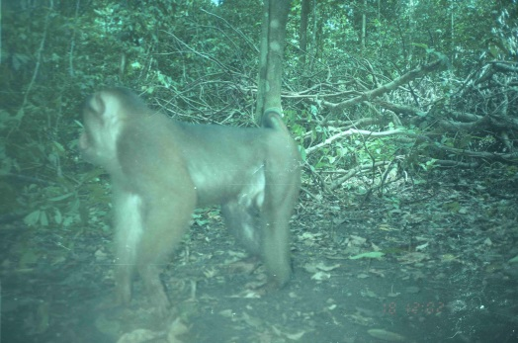
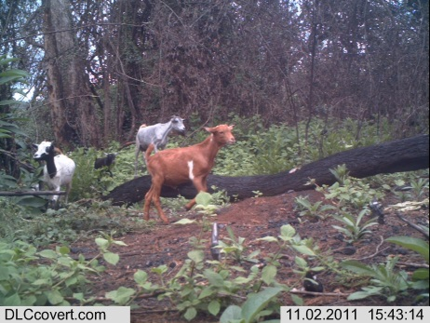
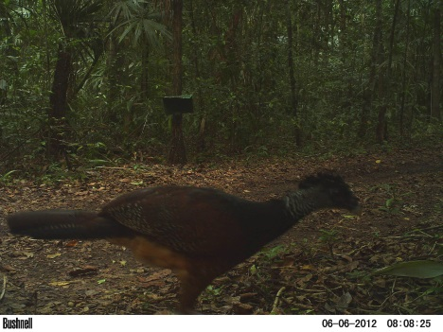
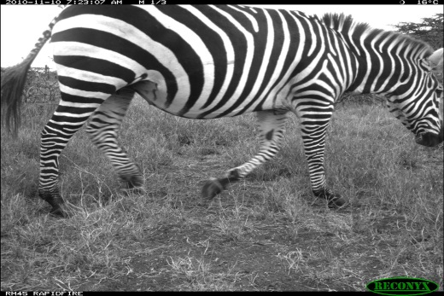
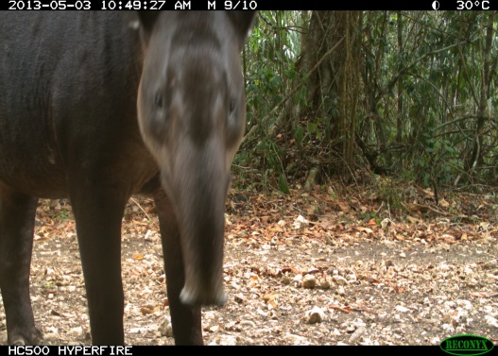
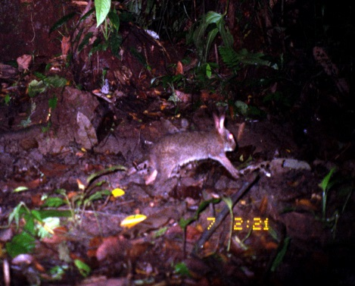
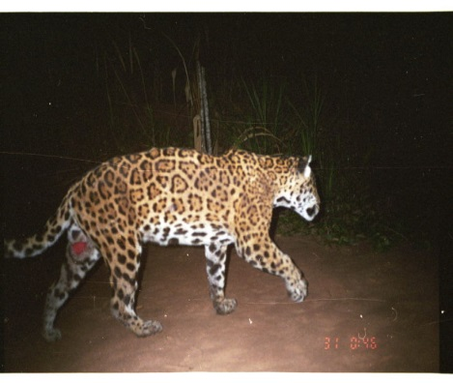
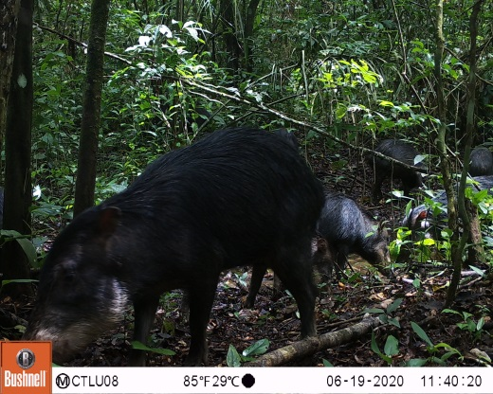
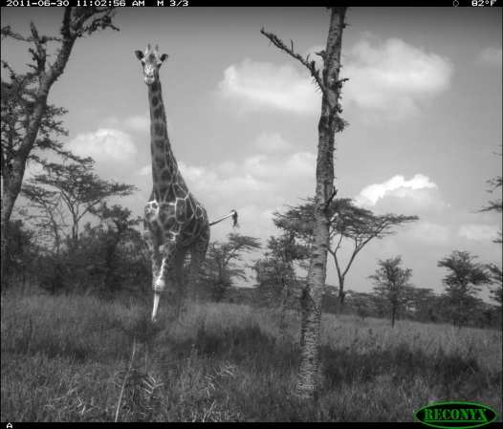
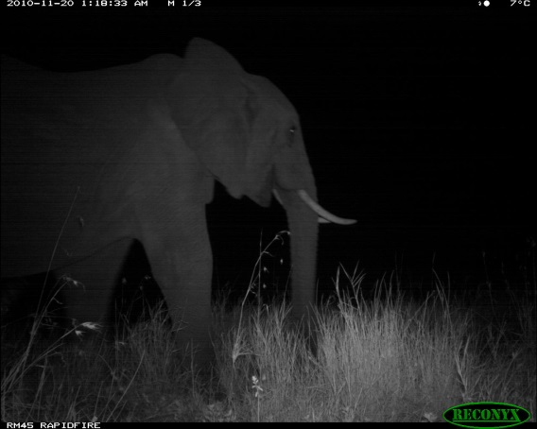
Images of Classes

Slide 9
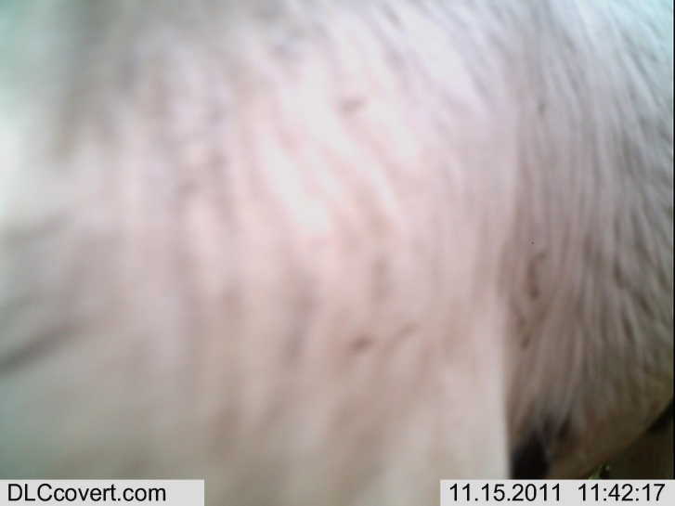
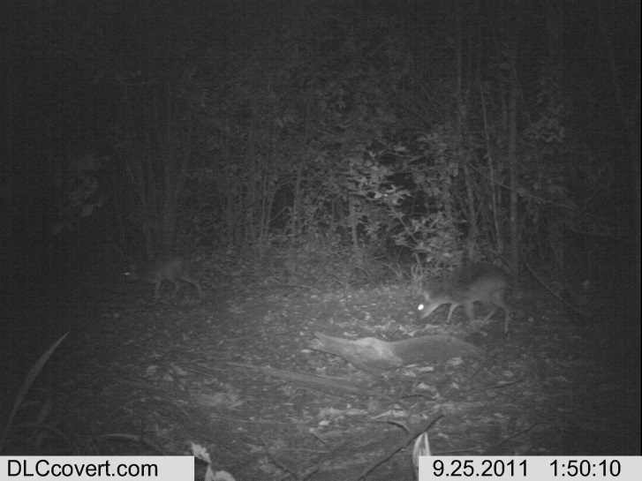
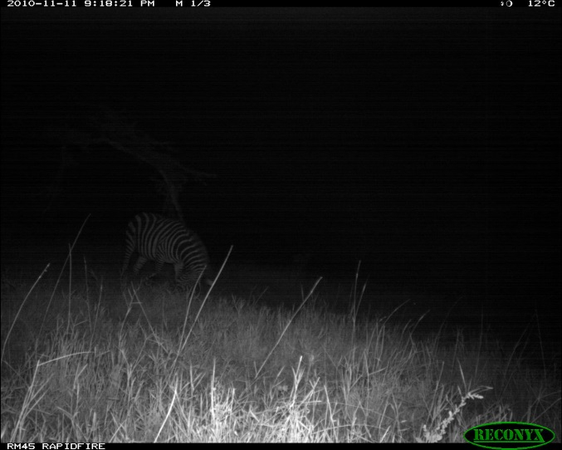
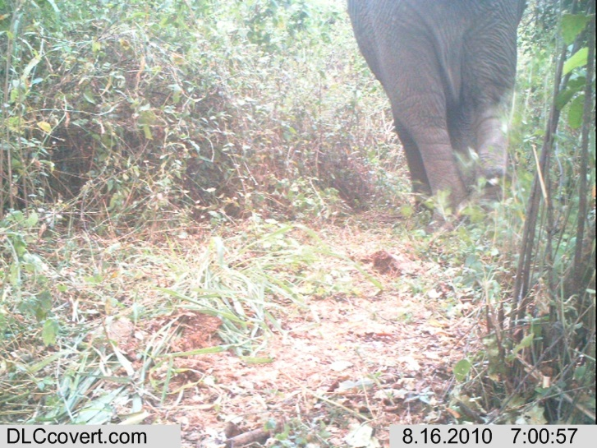
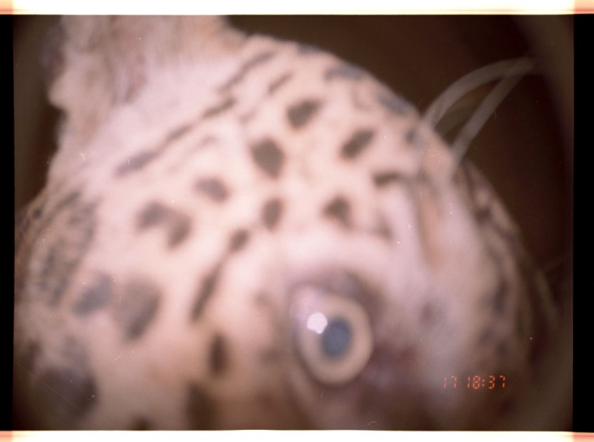
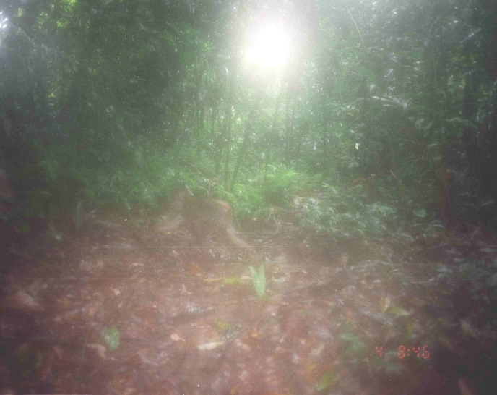
Different Scenarios

Slide 10
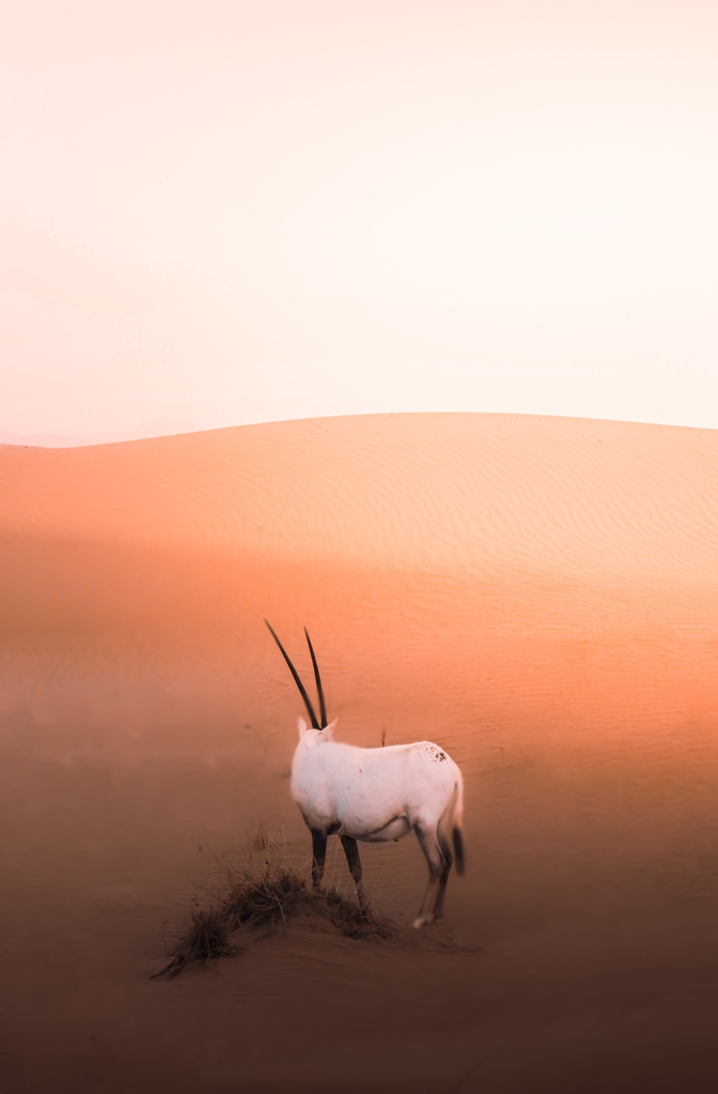
Approaches
There are mainly 3 different models are developed:
SVM Classifier
Naive Bayes
CNN
From Scratch
VGG -16
ResNET50
EfficientNetB7
Tensorflow, Keras and sklearn frameworks are used in these approaches.
Dataset is fed into Tensorflow’s ImageDataGenerator library.

Slide 11
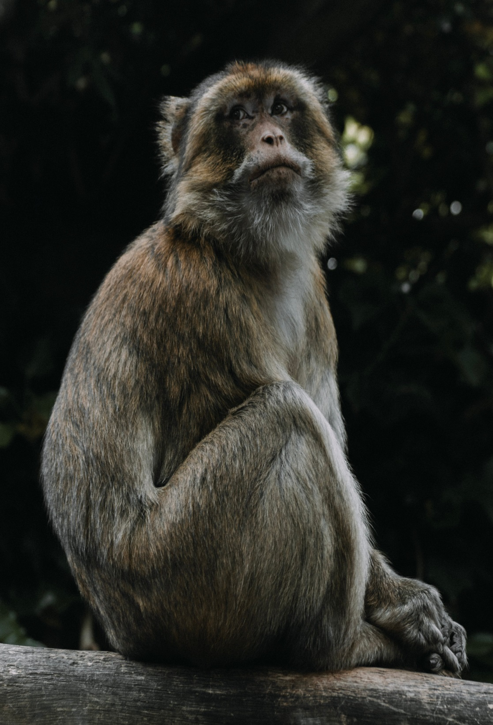
Applied Techniques
Data Augmentation
Brightness Operation
Brightening only the night images.
Zooming
Rotation
Rescaling (Between 0-1)
Data Processing
Histogram of Oriented Gradients for SVM Classification

Slide 12
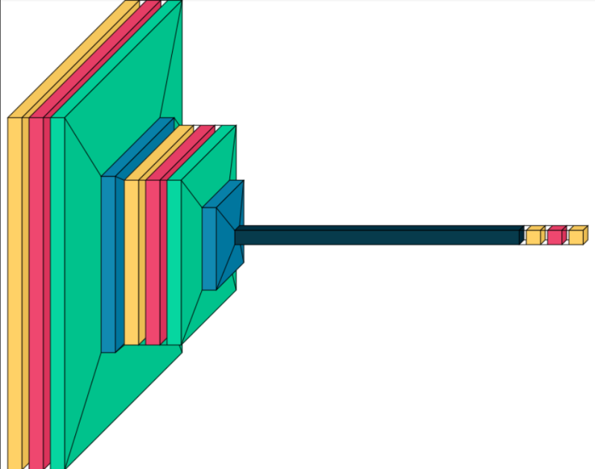
Modeling (Scratch CNN Model)
2 Convolutional Layers
2 Pooling Layers
2 FC Layers
1739226 total parameters.
Number of convolutional filters are 32 in first cl, 16 in second cl.
Size of the filter is determined as (5,5).
‘’ReLu’’ activation function is used for hidden layers and ‘’softmax’’ activation function is used for the output layer.
‘’Adam’’ optimizer is used with
lr= 0.0000075
Figure 4, Visualization of the model.
Regularization Techniques
-> Batch Normalization
-> L2 Regularization
->Dropout
->Early Stopping
->Reduction of Learning Rate

Slide 13
Modeling (VGG -16)
Pretrained VGG model, with all layers freezed, which contains
13 convolutional layers,
5 pooling layers,
2FC layer added manually.
2 FC layers (units = 256,10)
Dropout Layer (0.5)
21140042 total,
6425354 trainable parameters.
‘’Adam’’ optimizer is used with learning rate = 0.0001.
‘’Learning rate reduction’’ and ‘’early stopping’’ techniques are applied to prevent overfitting.
Figure 5, architecture of VGG-16

Slide 14
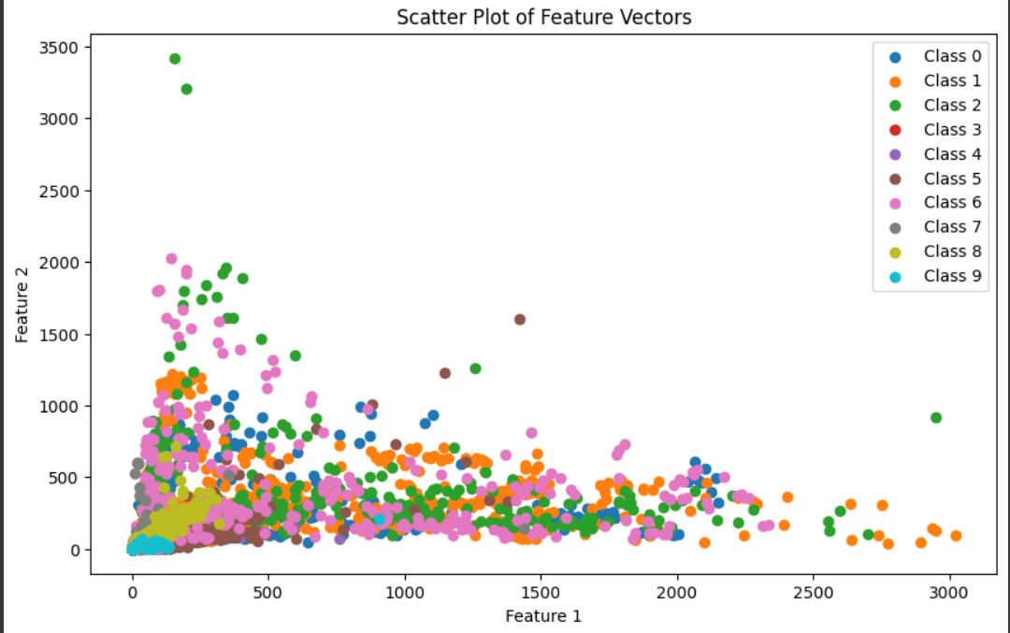
Modeling (SVC)
GridSearcCV was run and k-fold technique is used for detecting the best SVM classifier model.
The best results are gathered when C value is 100, kernel is ‘’rbf (radial basis function’’ and scaled gamma.
Since the hog features of the data is non linearly seperable, ‘’rbf’’ kernel was chosen.

Slide 15
Modeling (ResNet50)
Pretrained Resnet50 model, which contains
1 convolutional layers,
4 Resblocks pooling layers,
2FC layer added manually.
‘’Learning rate reduction’’ and ‘’early stopping’’ techniques are applied to prevent overfitting.
31979146 total parameters.
‘’Adam’’ optimizer is used with learning rate = 0.0005.
Figure 3, architecture of ResNet50

Slide 16
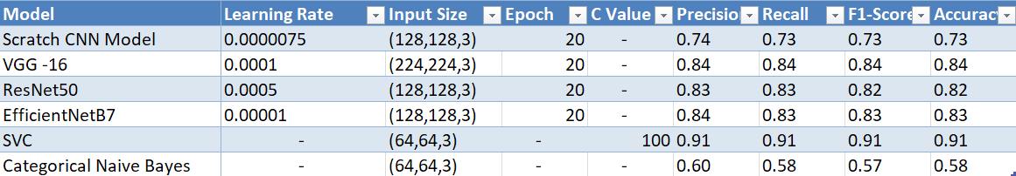
Model Comparison
Figure 7, table of the developed models with the parameters which result the best.
According to the metrics, SVC is the best model for our problem.
Transfer Learning model’s could be perform better with more hyperparameter tuning.

Slide 17
References
https://blog.gramener.com/top-10-ways-technology-is-protecting-endangered-species/
https://lila.science
https://macleans.ca/society/science/infographic-charting-the-worlds-sixth-mass-exinction/

